Slide 1
Lecture 08:
DIMENSIONALITY REDUCTION
April 13, 2021
R. Jordan Crouser Smith College

Slide 2


Announcements
Friday April 16th at 3pm EST

Slide 3
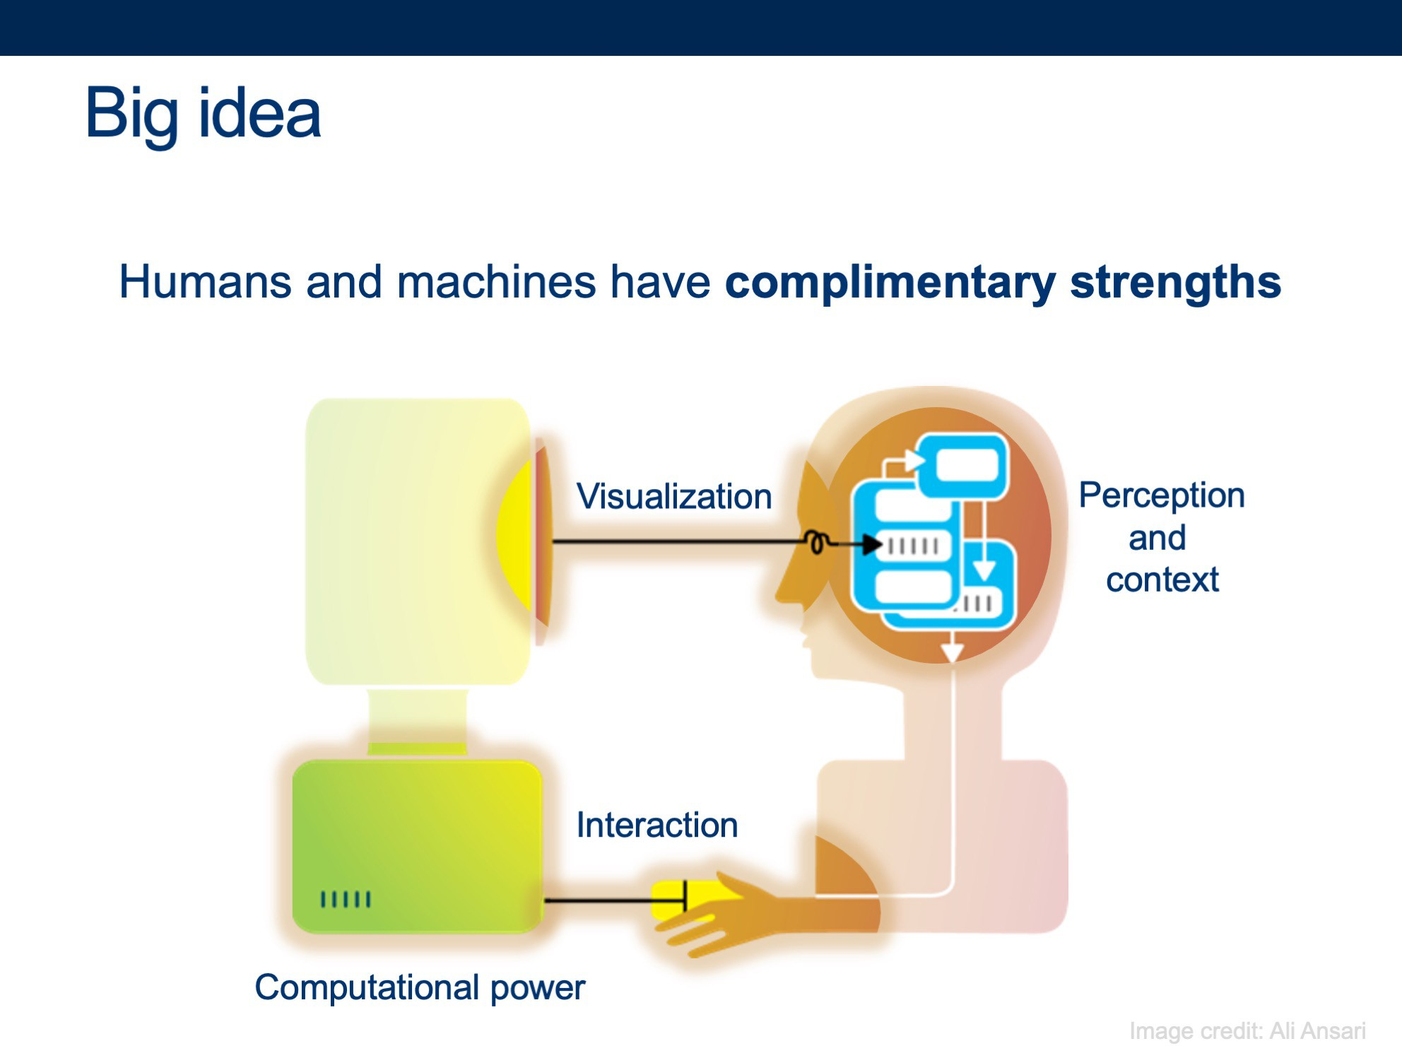
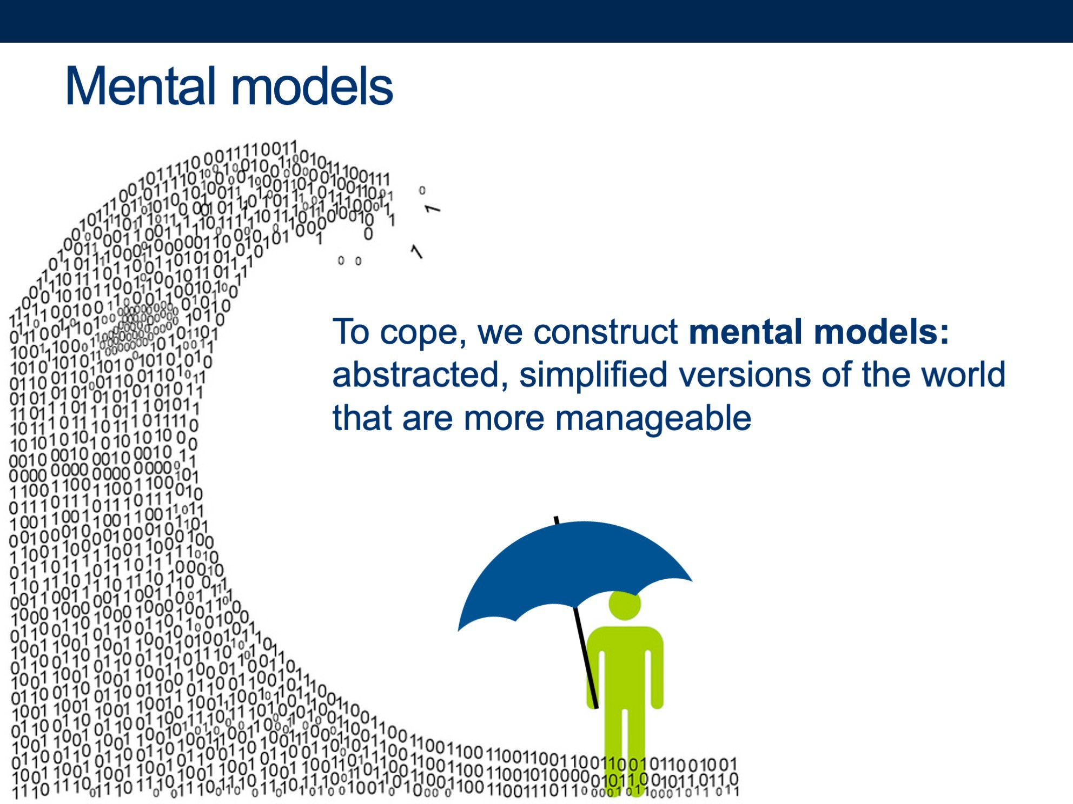
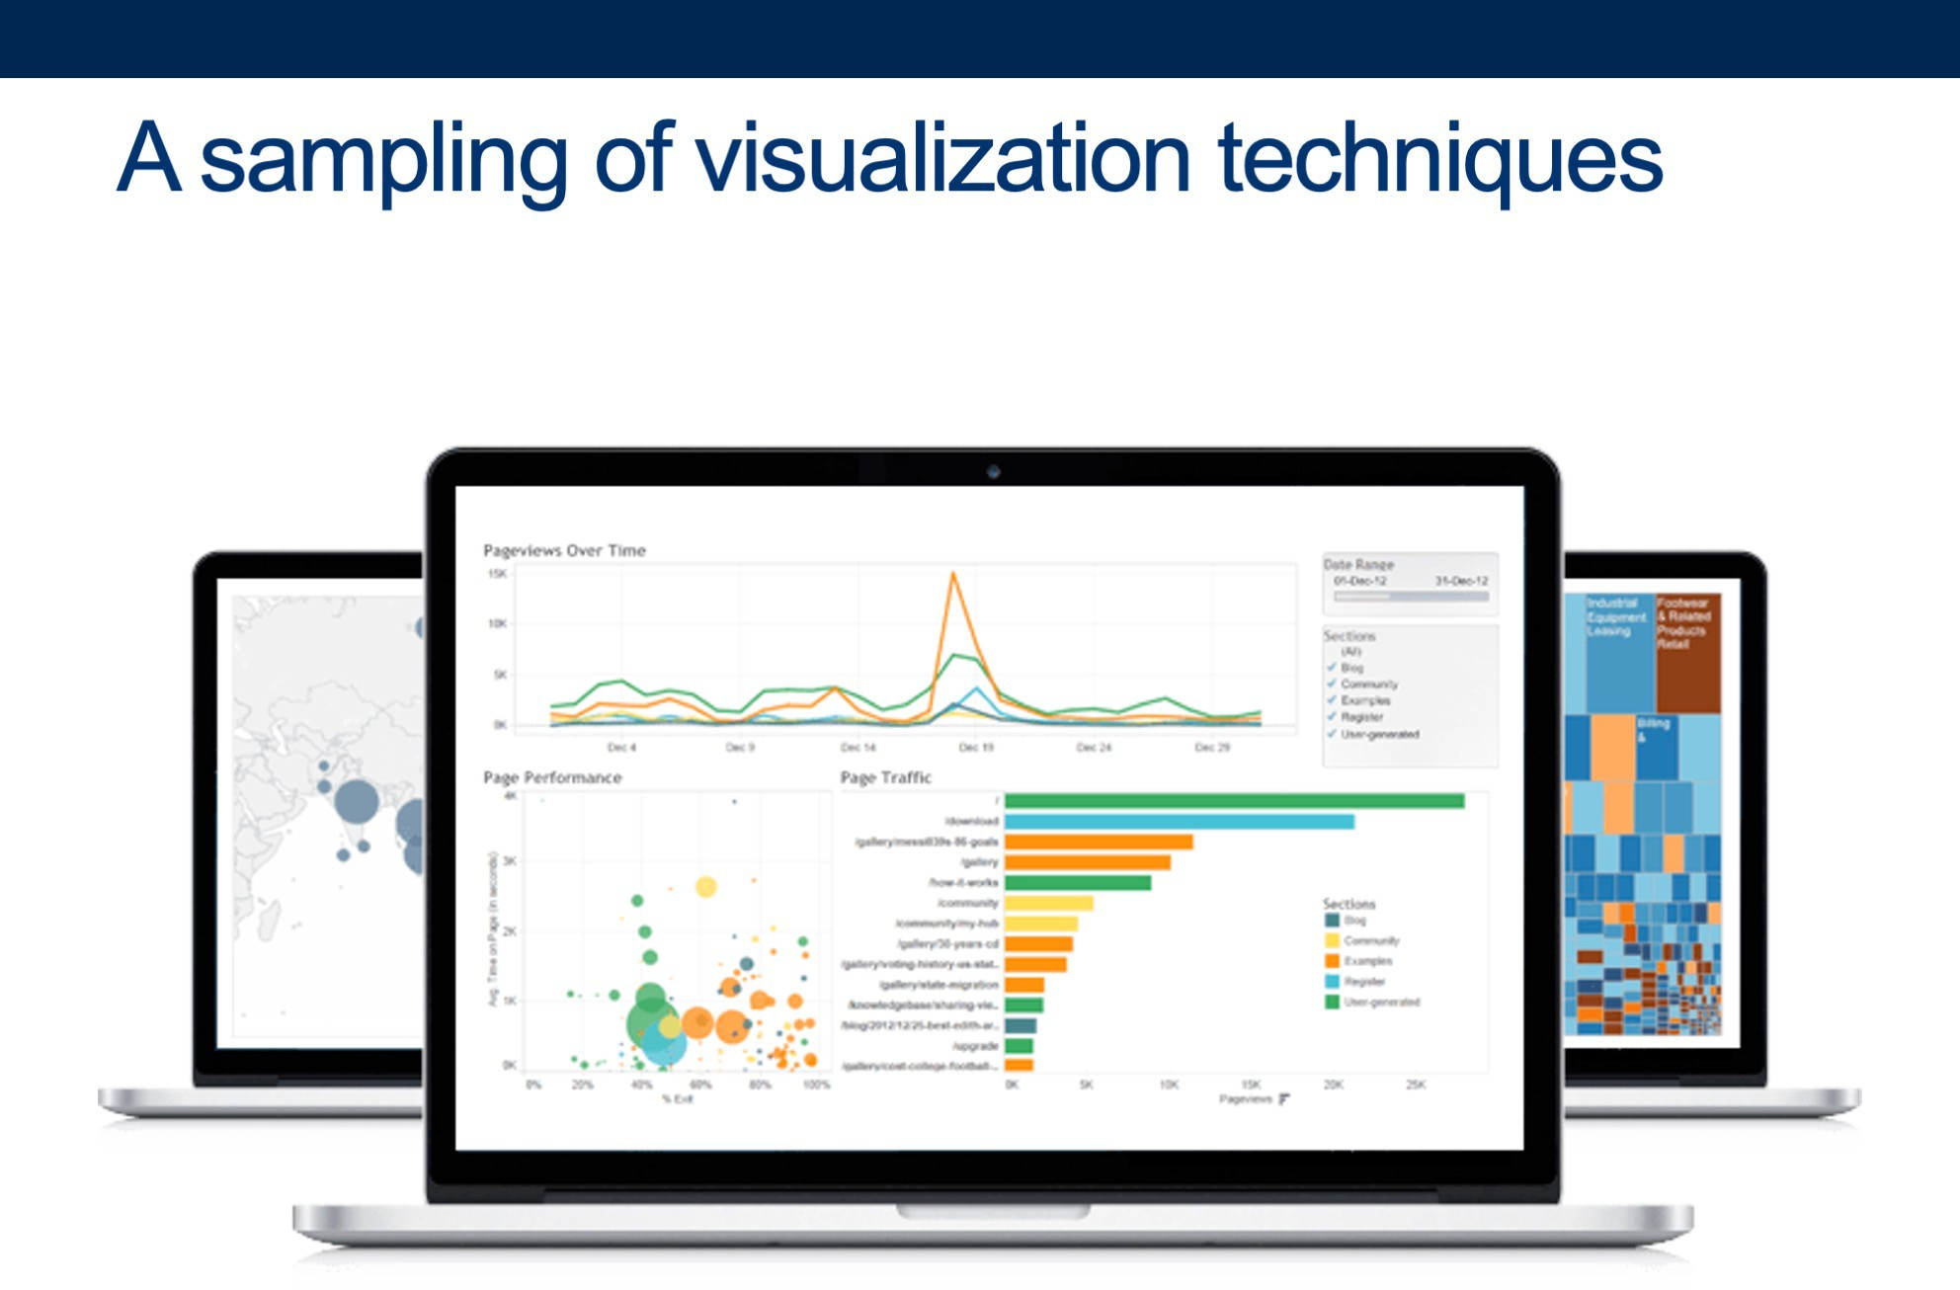
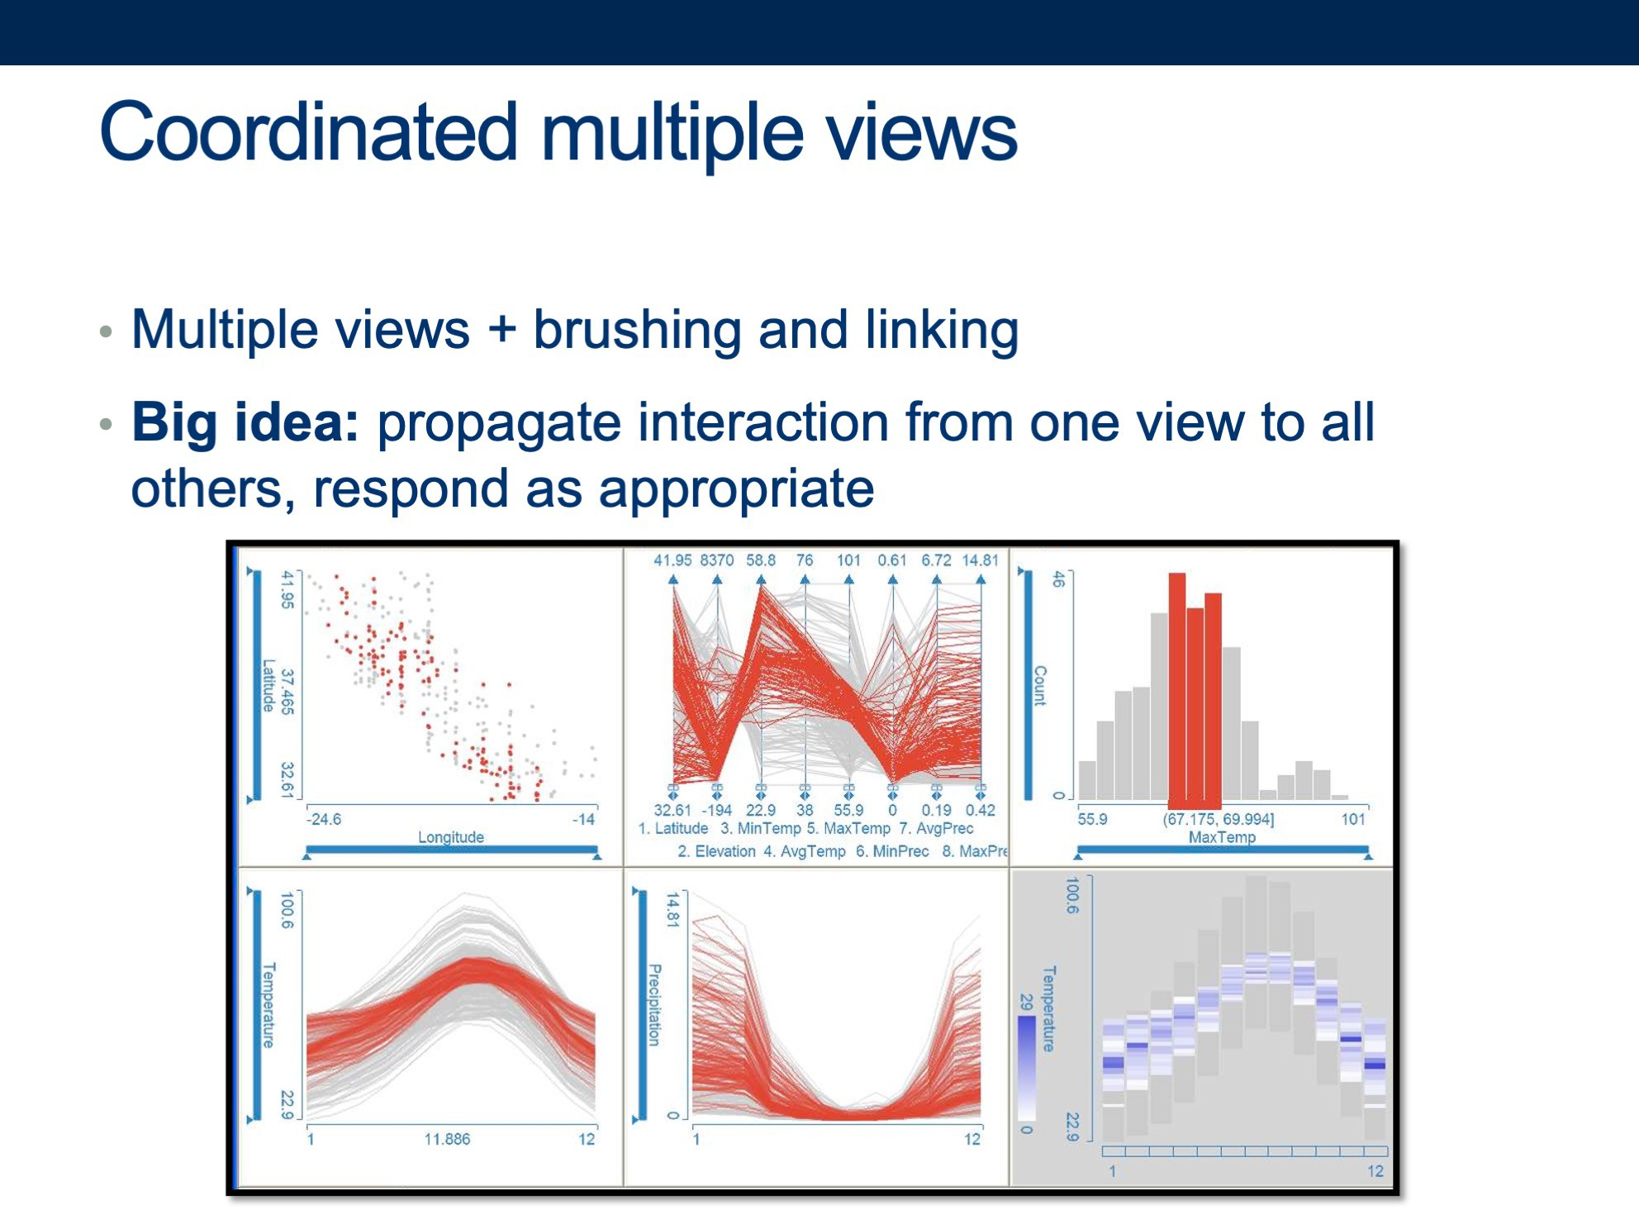
T-minus 5 weeks to go: let’s recap

Slide 4
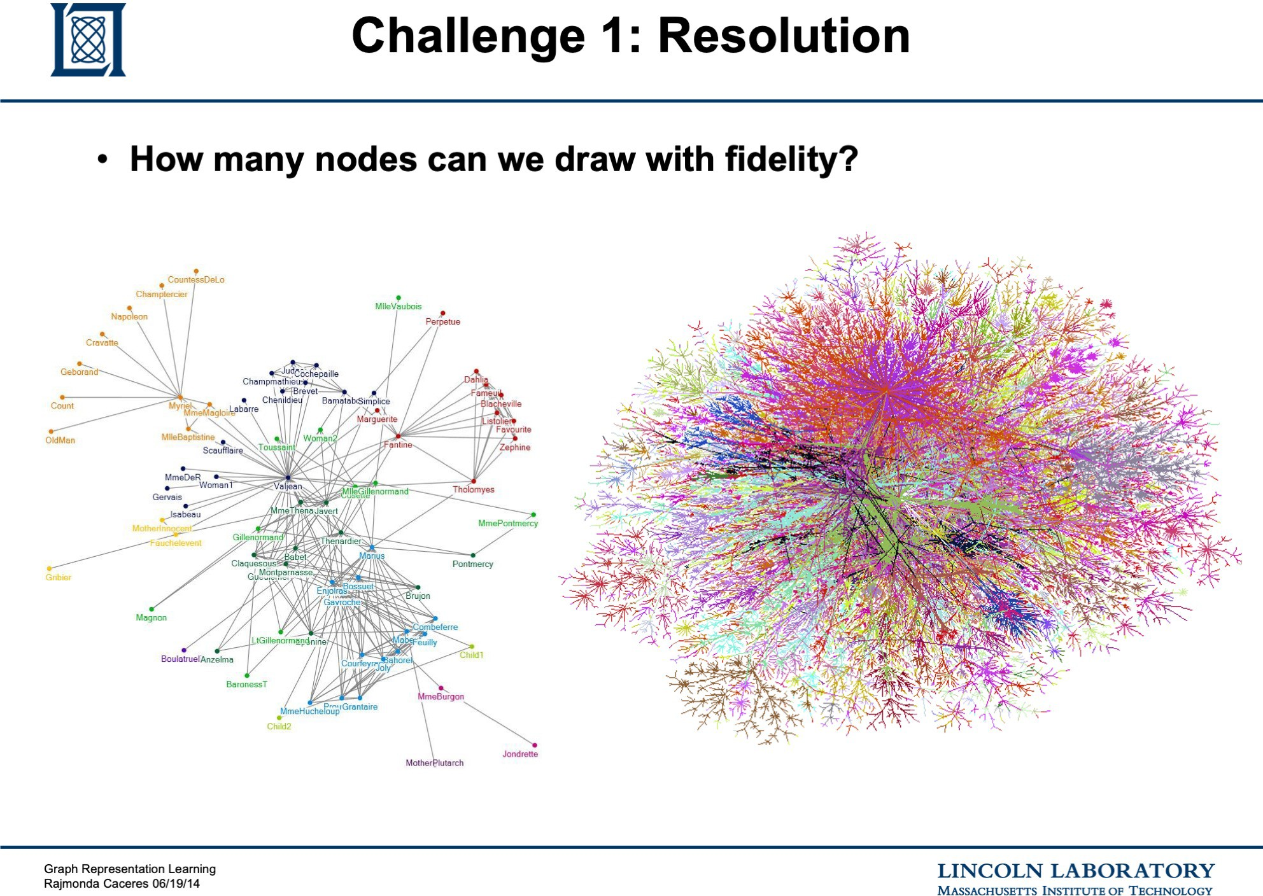

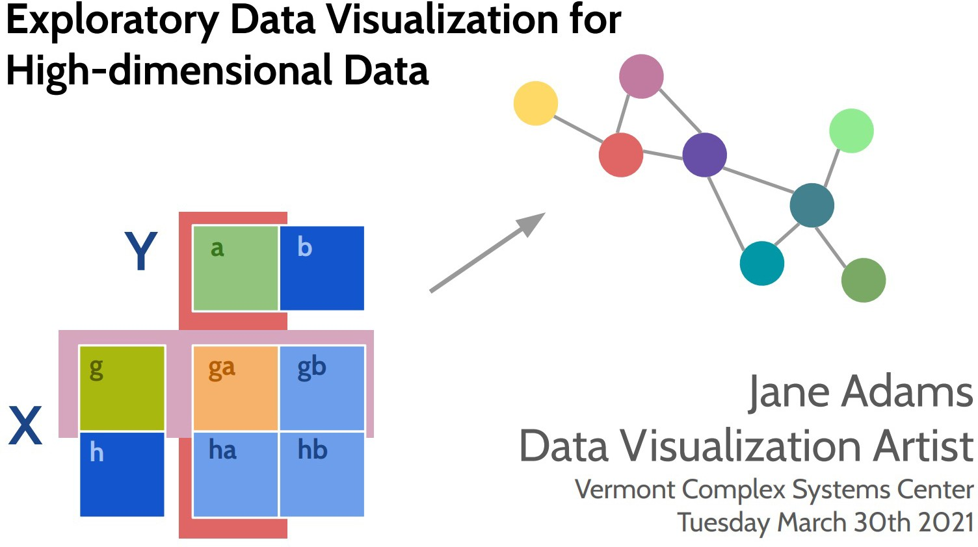
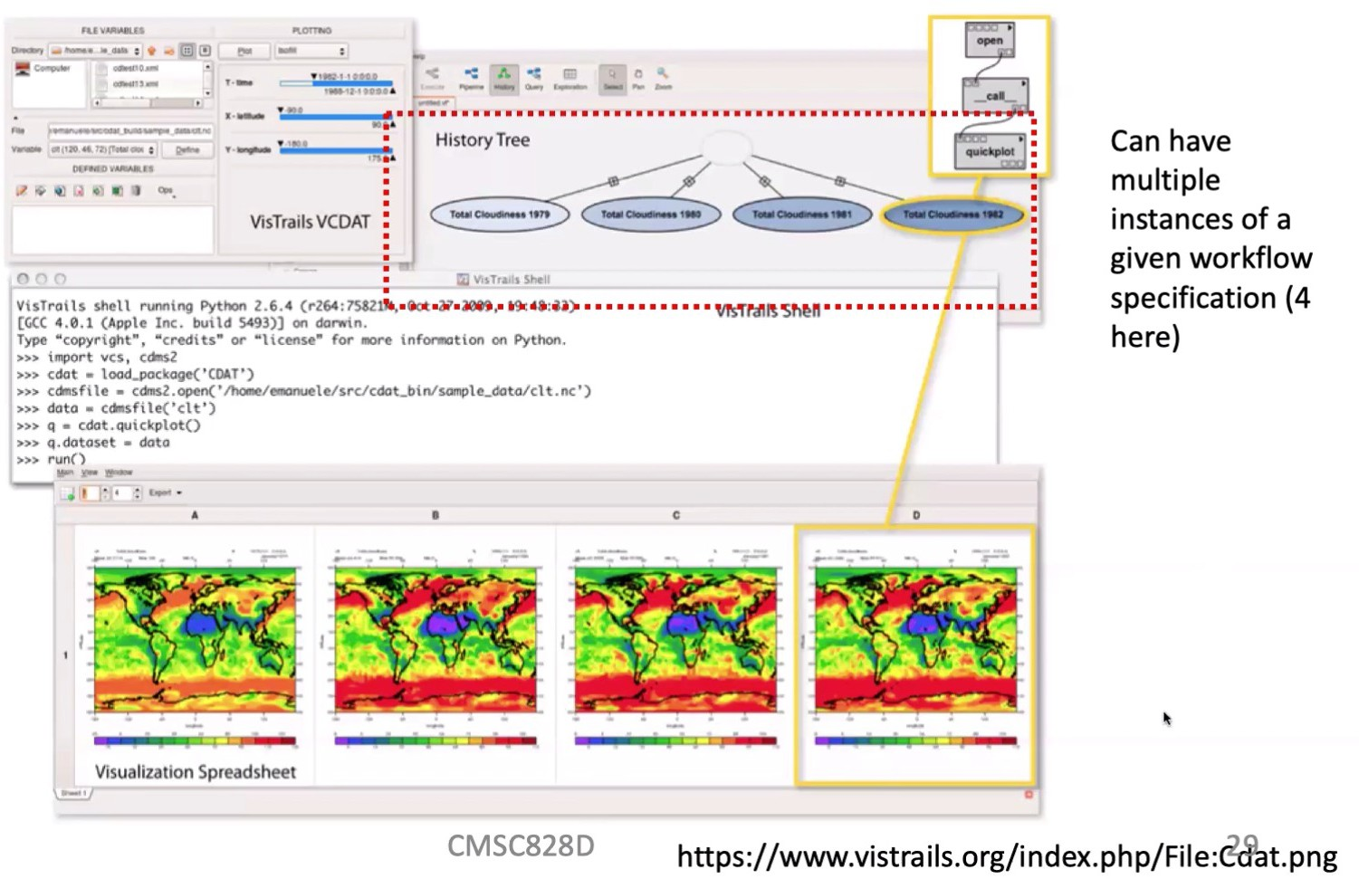
T-minus 5 weeks to go: let’s recap

Slide 5


Slide 6


Slide 7
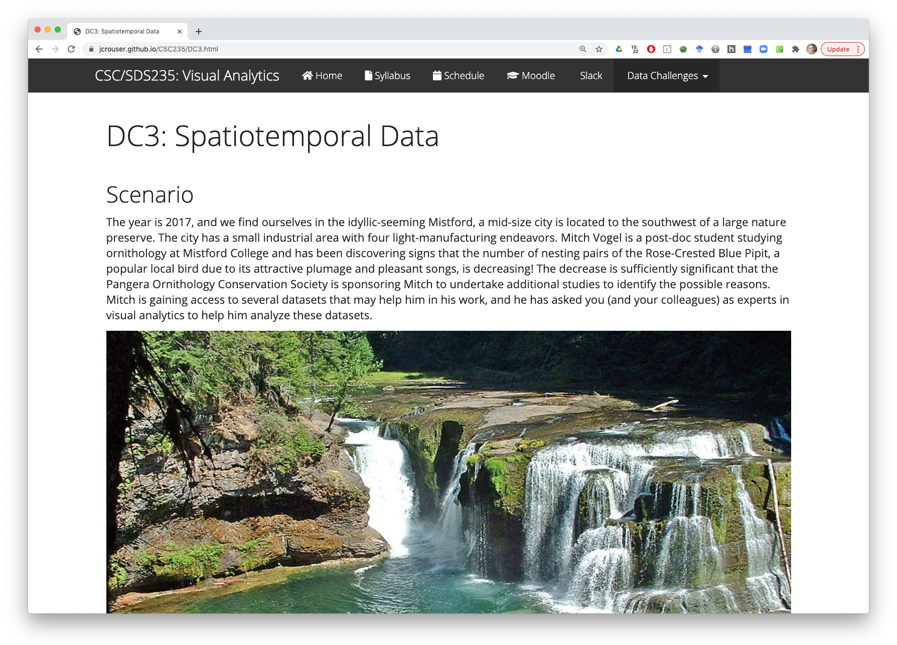

Slide 8
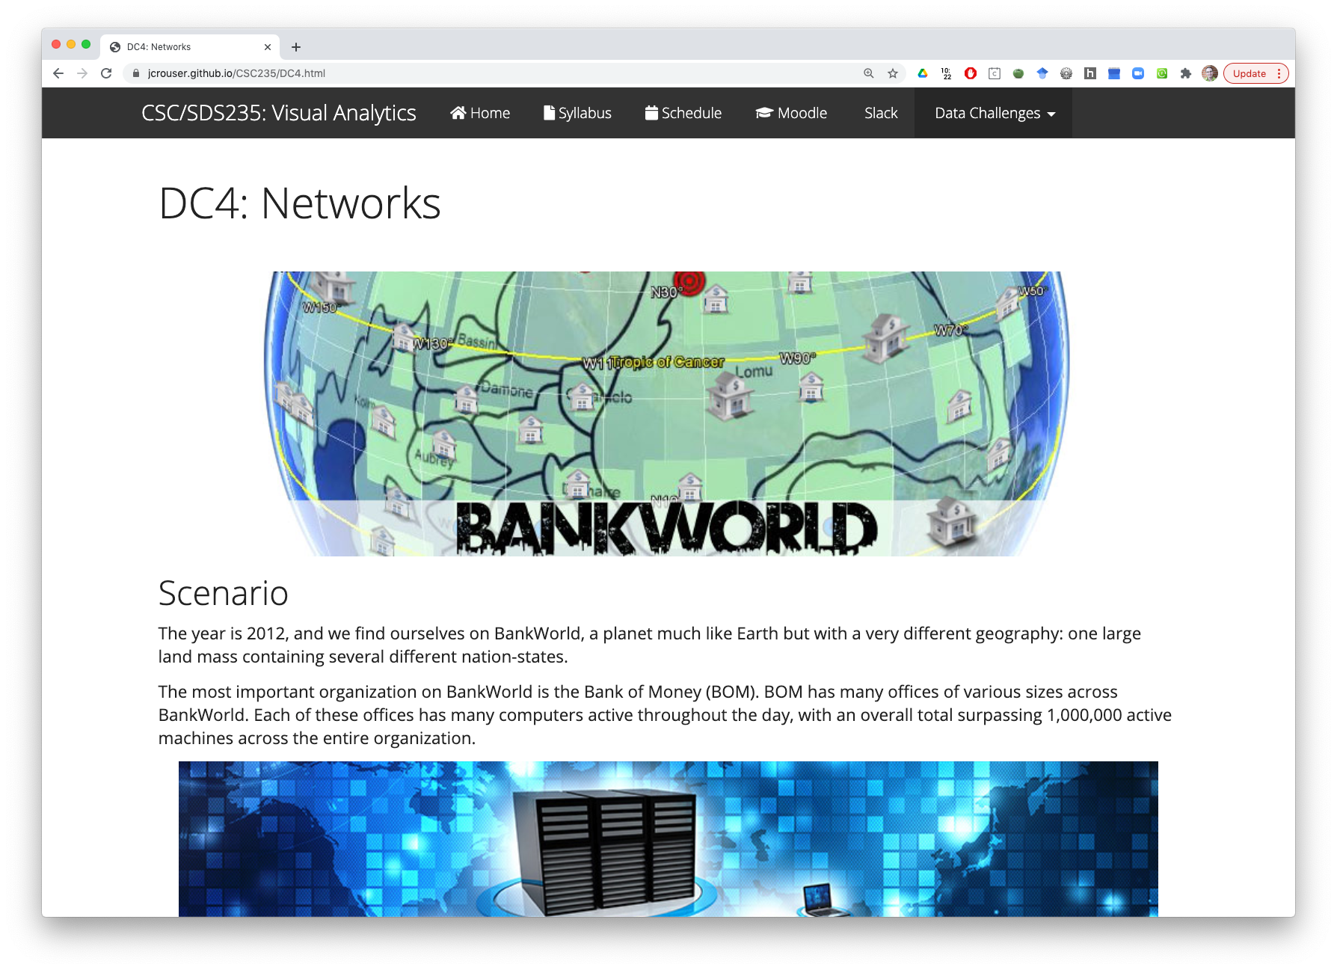

Slide 9


Slide 10
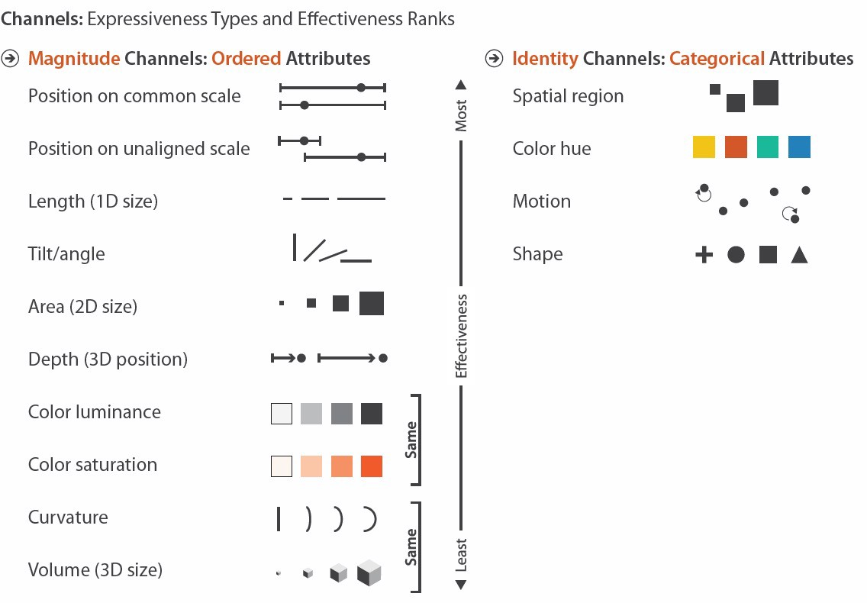

What we’ve been (mostly) worried about
So… what happens if dim(data) >> #channels?

Slide 11

Ideas?

Slide 12
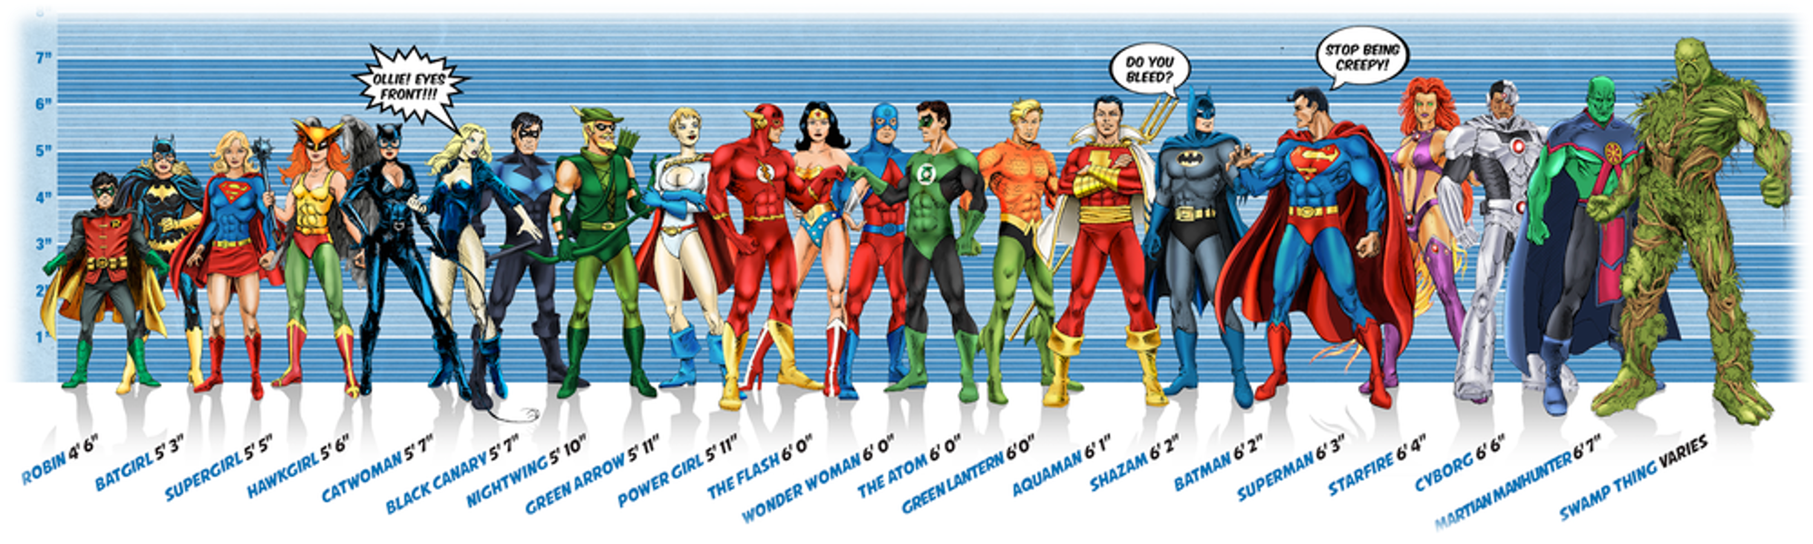



Toy problem: superheroes
⎛
height = β₁ ⎜
⎝
⎞ ⎛
⎞ ⎛
⎞
⎟
⎠
⎟+β₂ ⎜
⎟+β₃ ⎜
⎠ ⎝
⎠ ⎝
Image credit: Ming Malaykham

Slide 13

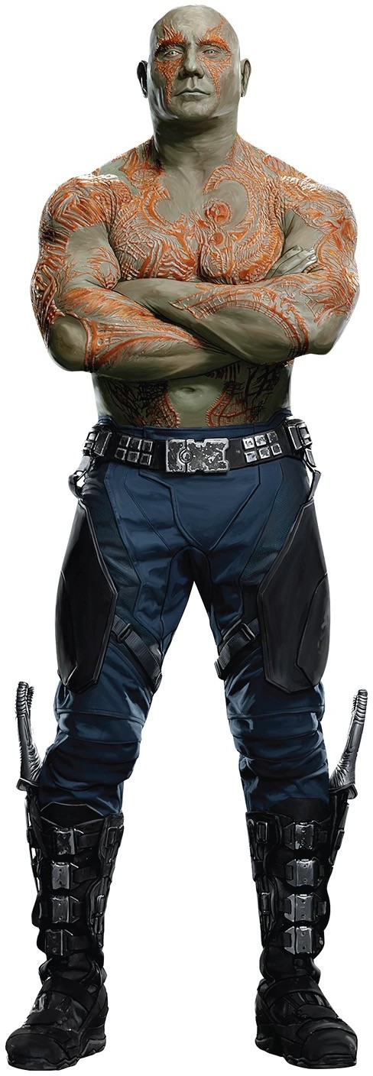



Estimating Guardians’ Height
⎡
⎢
⎢
ε₁
ε₂
⎤
⎥
⎥
⎥
⎥
⎥
⎥
⎥
⎦
⎡ ⎢ | 232.03 | ⎤ ⎥ | ⎡ ⎢ | 63.9 | ⎤ ⎥ | ⎡ ⎢ | 54.0 | ⎤ ⎥ | ⎡ ⎢ | 59.1 | ⎤ ⎥
⎢ | 156.29 | ⎥ | ⎢ | 28.9 | ⎥ | ⎢ | 45.1 | ⎥ | ⎢ | 36.9 | ⎥
⎢
⎢
⎢
⎢
⎣
⎥ ₌ ₁⎢
⎥₊ ₂⎢
⎥₊₁⎢
_{⎥+}⎢
113.82
229.07
287.72
54.3
69.8
50.4
13.3
49.5
85.4
33.7
59.7
67.9
⎢
⎢
⎢
⎢
⎣
ε
⎥ ⎢
⎥ ⎢
⎥ ⎢
⎦ ⎣
⎥ ⎢
⎥ ⎢
⎥ ⎢
⎦ ⎣
⎥ ⎢
⎥ ⎢
⎥ ⎢
⎦ ⎣
⎥
⎥
⎥
⎦
3
ε₄
ε₅

Slide 14
Estimate for �
When we try to estimate using OLS, we get the following:
6
estimated true
4
2
0
-2
i
i
(Relatively) huge difference between actual and estimated coefficients

Slide 15

What’s going on here?
⎡
⎢
ε₁
ε₂
⎤
⎥
⎥
⎥
⎥
⎥
⎥
⎥
⎦
⎡
⎢
⎢
⎢
⎢
⎢
⎢
⎣
232.03
156.29
113.82
229.07
287.72
⎤ ⎡
⎥ ⎢
63.9
28.9
54.3
69.8
50.4
⎤ ⎡
⎥ ⎢
54.0
45.1
13.3
49.5
85.4
⎤ ⎡
⎥ ⎢
59.1
36.9
33.7
59.7
67.9
⎤
⎥
⎥ ⎢
⎥ ⎢
⎥ ⎢
⎥
⎢
⎥ ₌ ₁⎢
⎥₊ ₂⎢
⎥₊₁⎢
_{⎥+}⎢
⎢
⎢
⎢
⎢
⎣
ε
⎥ ⎢
⎥ ⎢
⎥ ⎢
⎦ ⎣
⎥ ⎢
⎥ ⎢
⎥ ⎢
⎦ ⎣
⎥ ⎢
⎥ ⎢
⎥ ⎢
⎦ ⎣
⎥
⎥
⎥
⎦
3
ε₄
ε₅
≈ 𝑎𝑣𝑔
,
Some dimensions are redundant
Zero information in 3rd dimension not captured by the first two
If you’re using something like linear regression, redundancy causes noise to be amplified

Slide 16
Dimension reduction
Current situation: our data live in p-dimensional space, but not all p dimensions are equally useful
Subset selection: throw some out
Pro: pretty easy to do
Cons: lose some information, inject bias
Alternate approach: create new features that are combinations of the old ones
In other words:
Project the data into a new feature space to reduce variance in the estimate

Slide 17
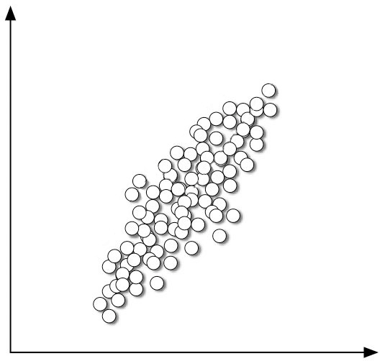
Projection

Slide 18








































Projection
SMOOSH!
SMOOSH!

Slide 19
Projection

Slide 20
Dimension reduction via projection
Big idea: transform the data before performing analysis (e.g. regression, etc.)
𝑋! 𝑋" 𝑋# 𝑋$ 𝑋% ↦ 𝑍! 𝑍"
Then instead of:
*
𝑌 = 𝛽& + % 𝛽'𝑋' + 𝜀
'()
we solve:
+
𝑌 = 𝜃& + % 𝜃'𝑍' + 𝜀
'()

Slide 21


Linear projection
New features are linear combinations of original data:
(
𝑍& = % 𝜃'& 𝑋'
'
LinAlg: multiplying the data matrix by a projection matrix
^{𝜑}),)
^{𝜑},,)
^{𝜑}-,)
^{𝜑}.,)
^{𝜑}/,)
^{𝜑}),,
^{𝜑},,,
^{𝜑}-,,
^{𝜑}.,,
^{𝜑}/,,
𝑍₎ 𝑍,
= 𝑋₎
𝑋,
𝑋₋ 𝑋. 𝑋/

Slide 22
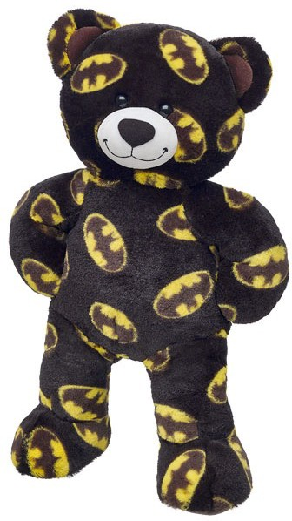
What’s the deal with projection?
Data can be rotated, scaled, and translated without changing the underlying relationships
This means you’re allowed to look at the data from whatever angle makes your life easier…

Slide 23
Wait, why did we pick this line?

Slide 24
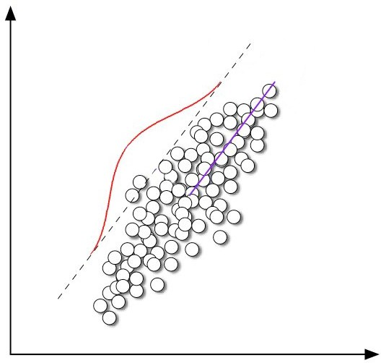
Explains the most variance in the data
Most variance

Slide 25
Imagine this line as a new dimension…
Most variance

Slide 26

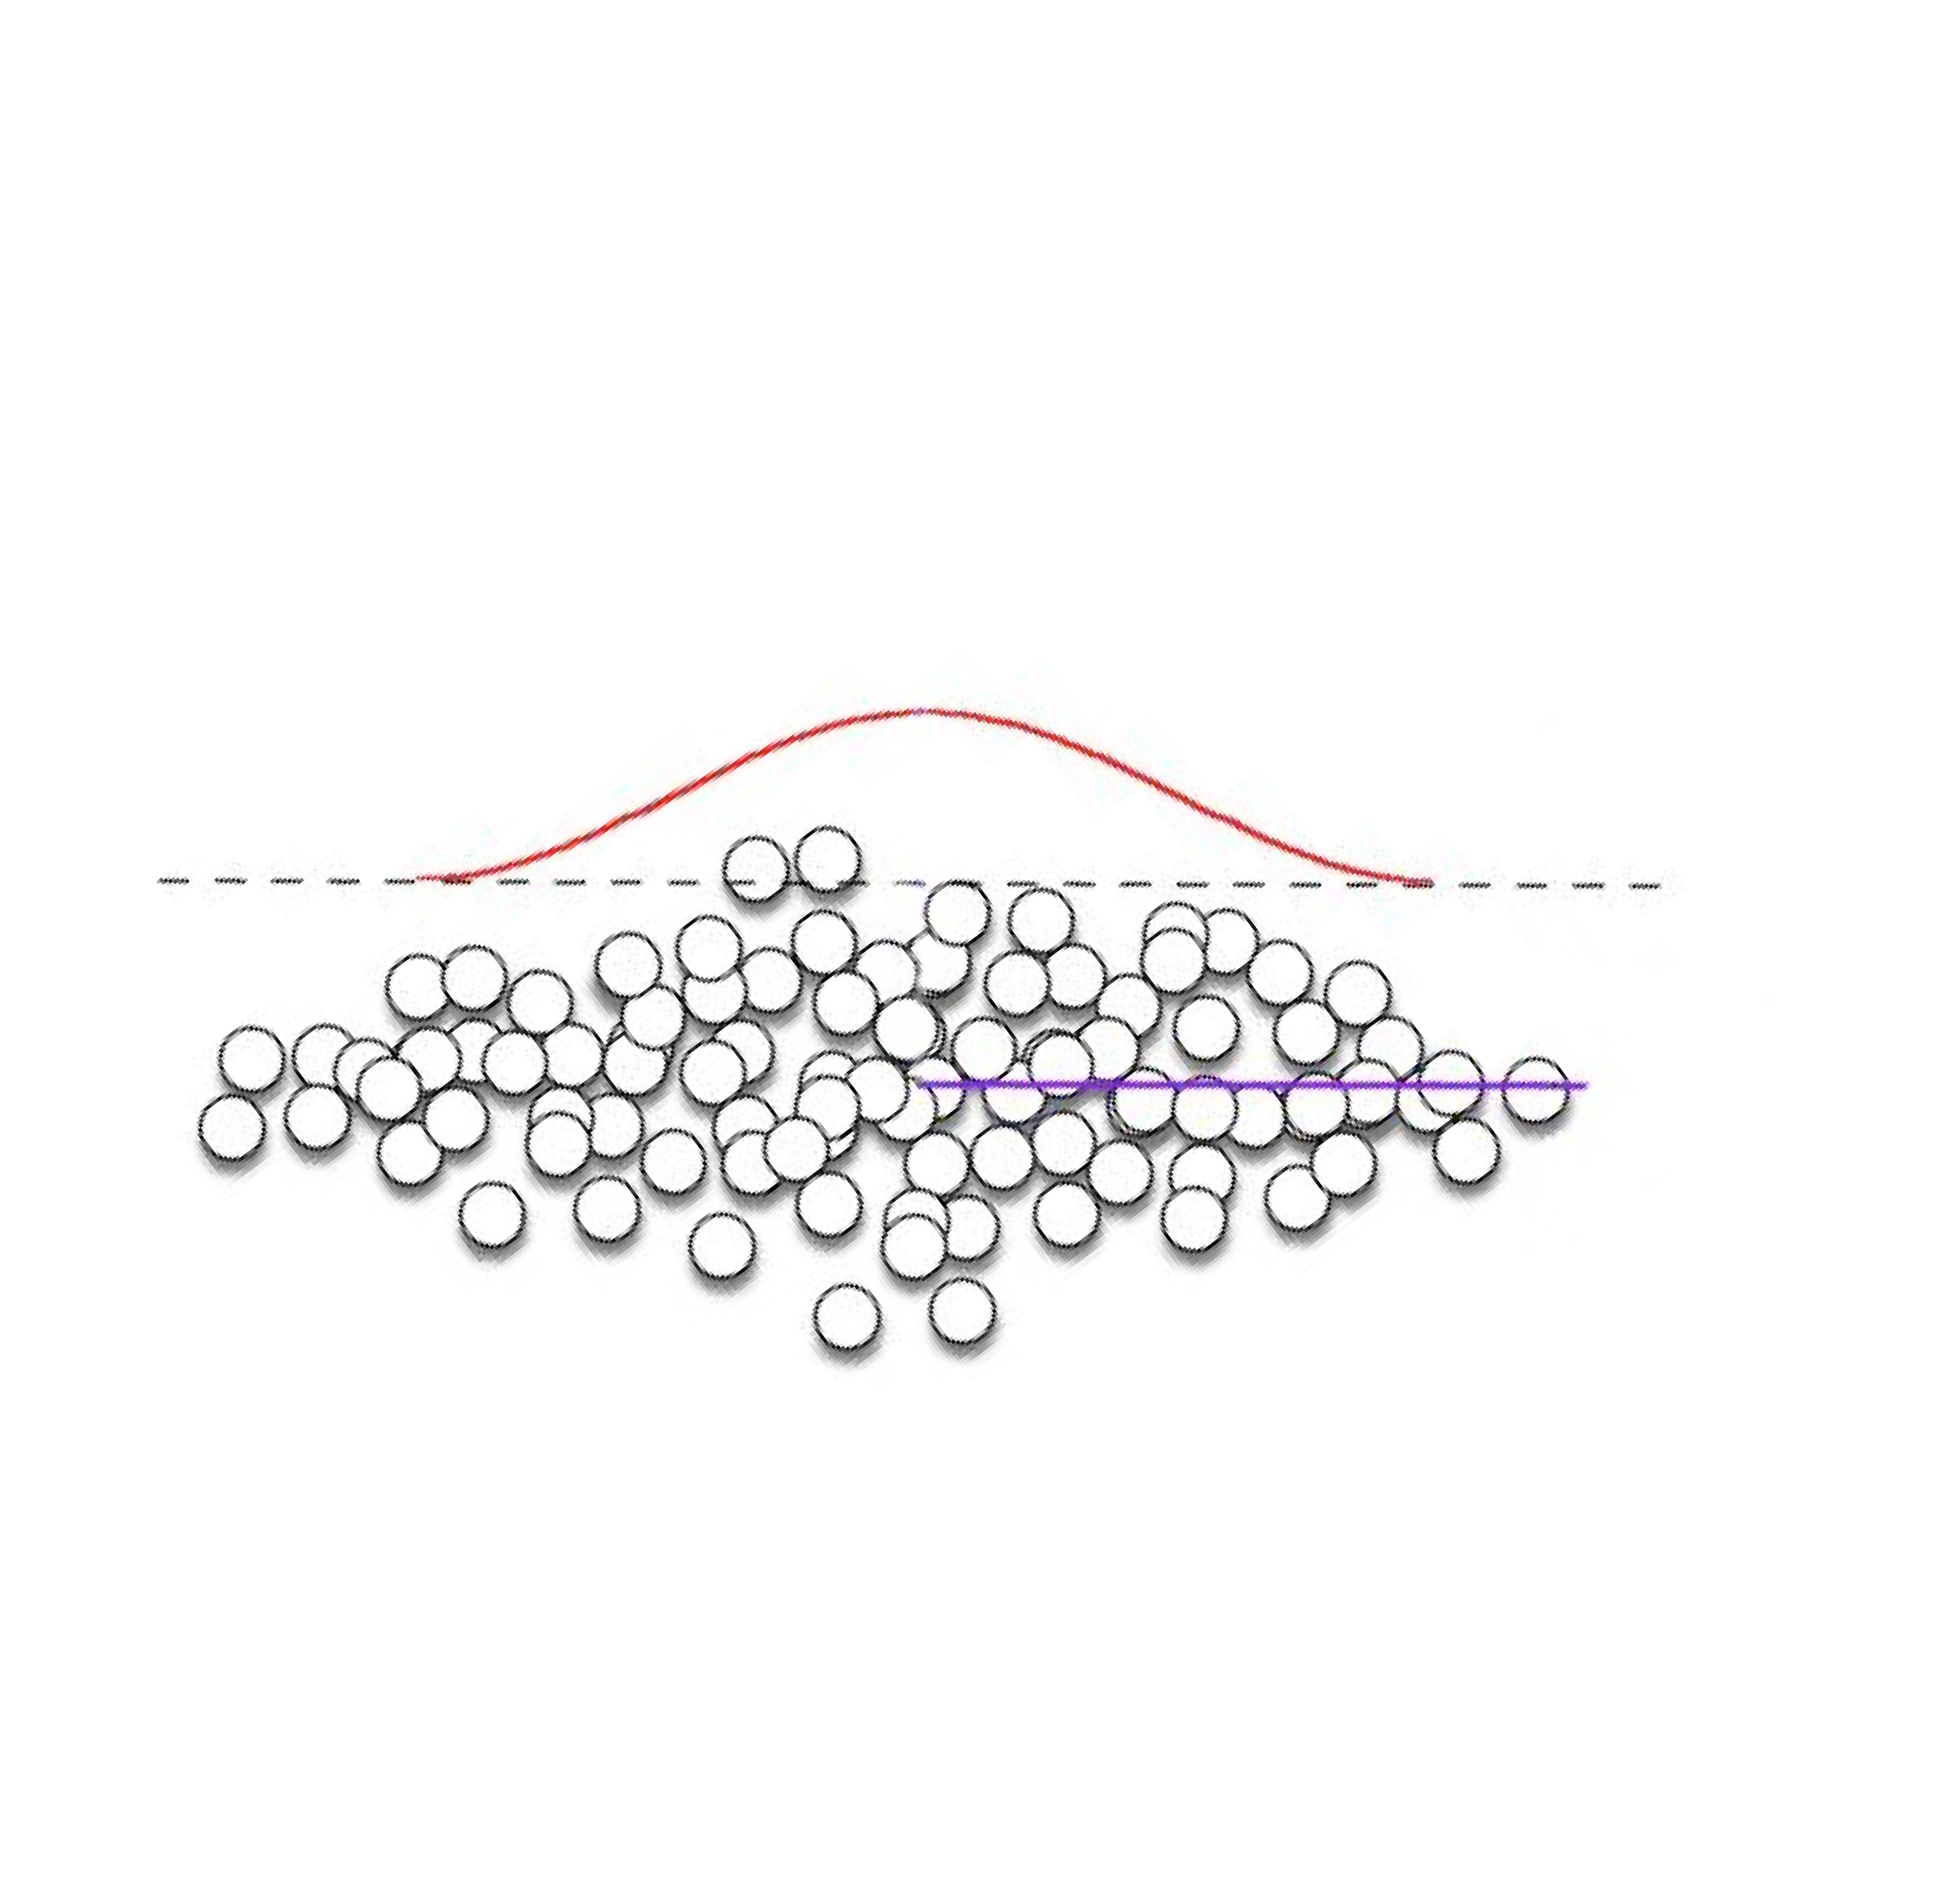

“Principal component”
Most variance

Slide 27
Mathematically
The 1st principal component is the normalized* linear combination of features:
𝑍! = 𝜙!!𝑋! + 𝜙"!𝑋" + ⋯ + 𝜙_{)!}𝑋₎
that has the largest variance
𝜙₎₎, … , 𝜙_{*)}: the loadings of the 1st principal component
$
* By normalized we mean: ! 𝜙% = 1
!#
!"#

Slide 28

Using loadings to project
Multiply by loading vector to project (“smoosh”) each observation onto the line:
^{𝑧}') ^{= 𝜙}))^{𝑥}') ^{+ 𝜙},)^{𝑥}', ^{+ ⋯ + 𝜙}*)^{𝑥}'*
These values are called the scores
of the 1st principal component

Slide 29
Additional principal components
2nd principal component is the normalized linear combination of the features
𝑍" = 𝜙!"𝑋! + 𝜙""𝑋" + ⋯ + 𝜙_{)"}𝑋₎
that has maximal variance out of all linear combinations that are uncorrelated with Z₁ (why does that matter?)
Fun fact:

Slide 30
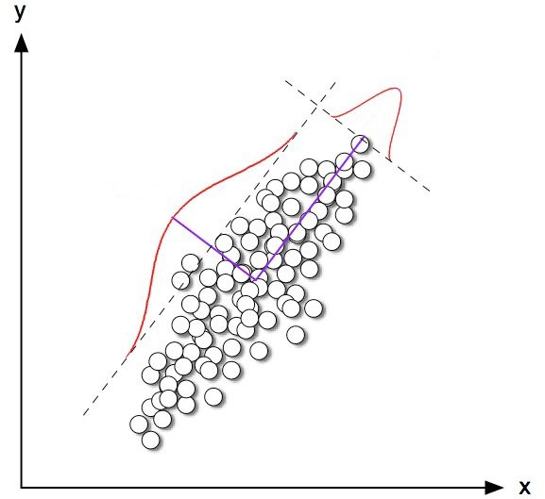
Principal components are orthogonal
2
nd
most variance

Slide 31
Generating additional principal components
Think recursively
To find the 𝑀^{𝑡ℎ} principal component . . .
Find the first (𝑀 − 1) principal components
Subtract the projection into that space
Maximize the variance in the remaining complementary space

Slide 32
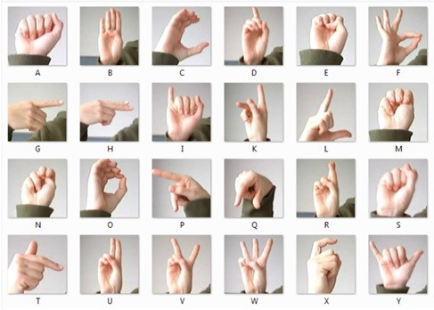
Example
Sign-Language-MNIST (27,455 examples of 26 letters)
Example credit: Sivakar Sivarajs, Towards Data Science

Slide 33
Example
Sign-Language-MNIST (27,455 examples of 26 letters)
Example credit: Sivakar Sivarajs, Towards Data Science

Slide 34
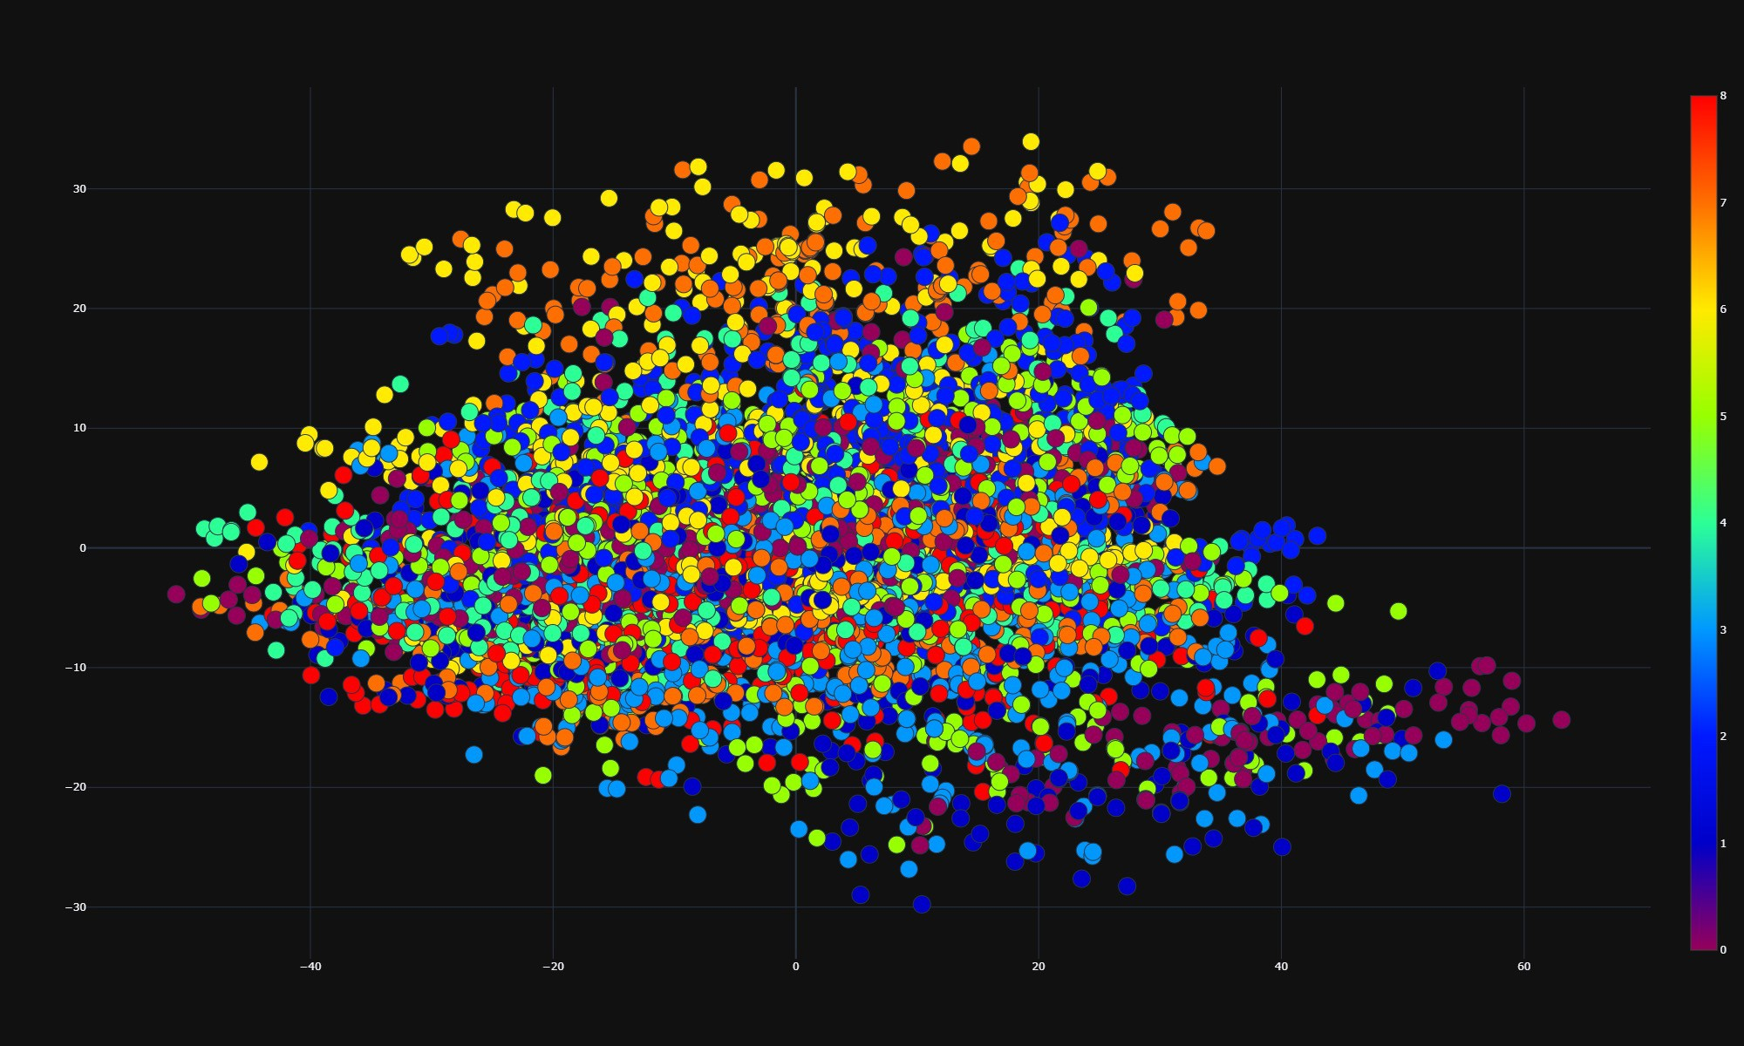
Example: 1st two PCs
Example credit: Sivakar Sivarajs, Towards Data Science

Slide 35
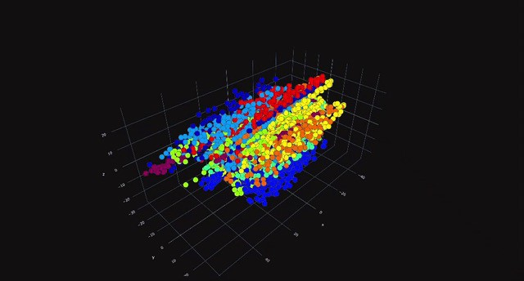
Example: 1st three PCs
Example credit: Sivakar Sivarajs, Towards Data Science

Slide 36
Potential issues with PCA?

Slide 37
New idea
What if we could use any distance metric, and took that into account when finding new dimensions?
Goal: preserve hi-dim pairwise distance in projection
“similar” stuff stays close together
“different” stuff can move apart

Slide 38
MDS (“Multidimensional Scaling”)
Choose a good distance metric
Compute a pairwise distance matrix
Find a 2D embedding that preserves those distances
(the distance matrix kind of acts like a stress tensor, so you can think of MDS kind of like a “force directed” layout but without visible edges)
Fun (but also sad) fact:
PCA is just a special case of MDS
(if we use Euclidean distance and choose the 1st two components)

Slide 39
Potential issues with general MDS?

Slide 40
t-SNE (t-Distributed Stochastic Neighbor Embedding)
Same objective: preserve pairwise distances
Different approach: instead of eigenanalysis on the pairwise distance matrix, use field approximation
(which is iterative and stochastic, in addition to nonparametric)

Slide 41
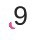
Example: t-SNE
Example credit: Cyrille Rossant

Slide 42
Example: 1st two PCs
Example credit: Sivakar Sivarajs, Towards Data Science

Slide 43
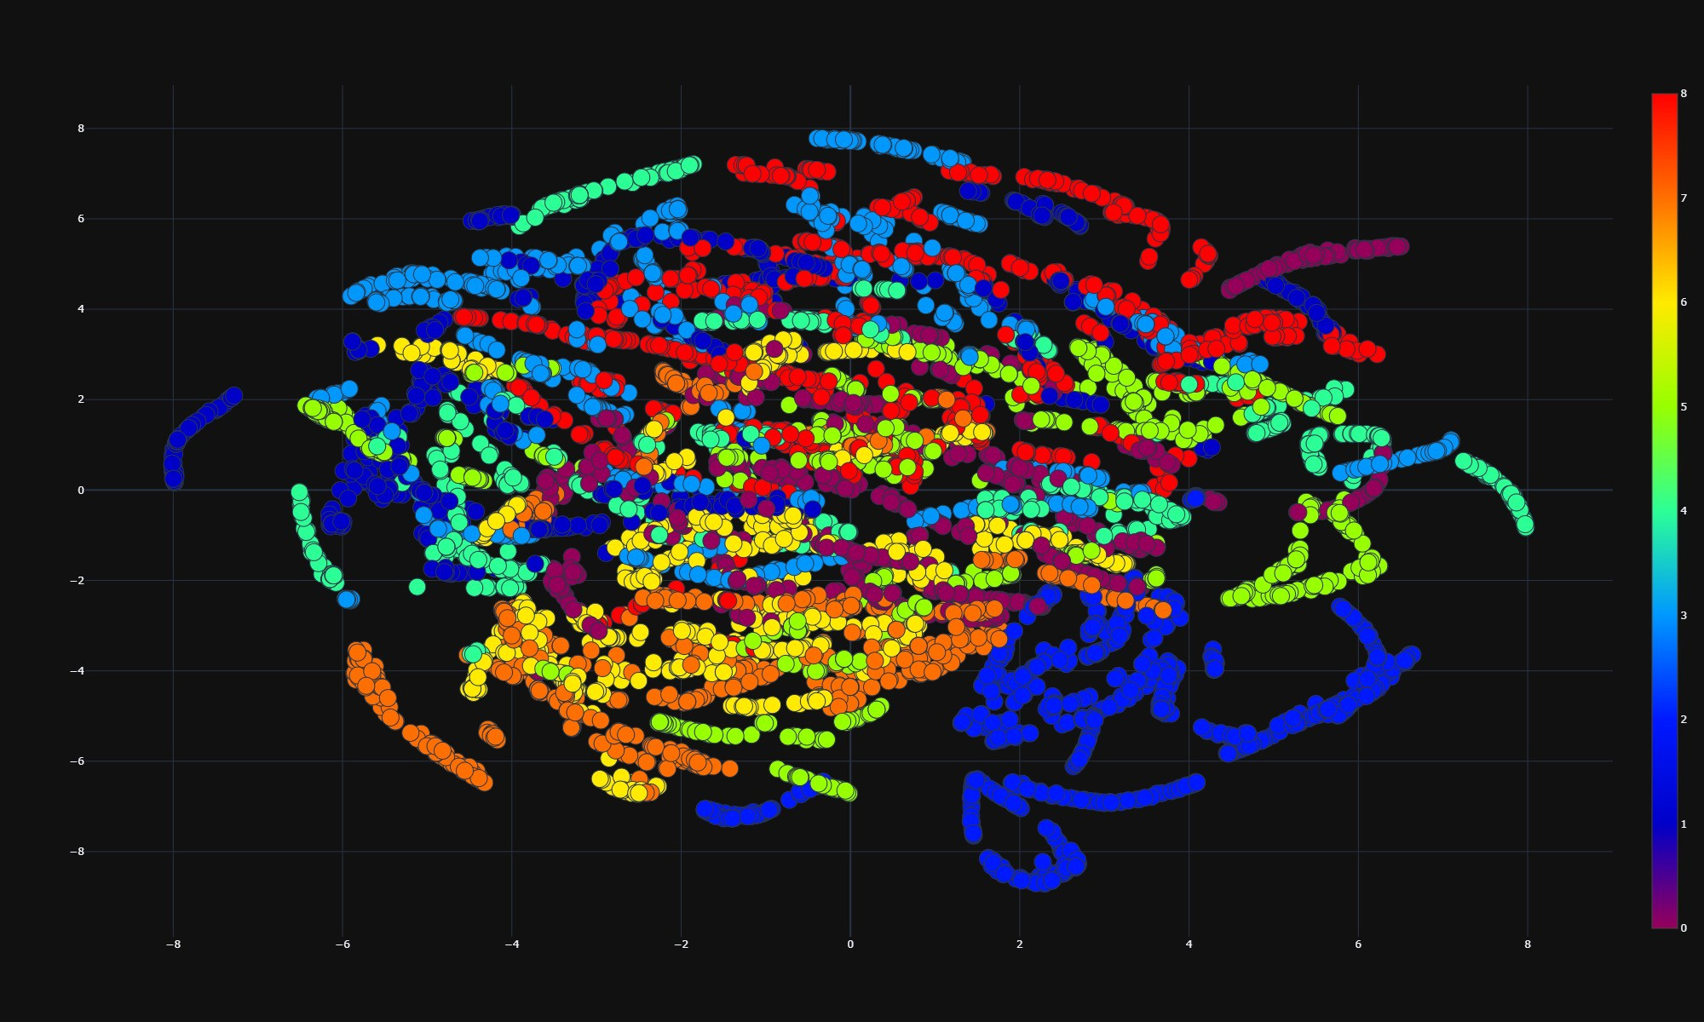
Example: t-SNE
Example credit: Sivakar Sivarajs, Towards Data Science

Slide 44
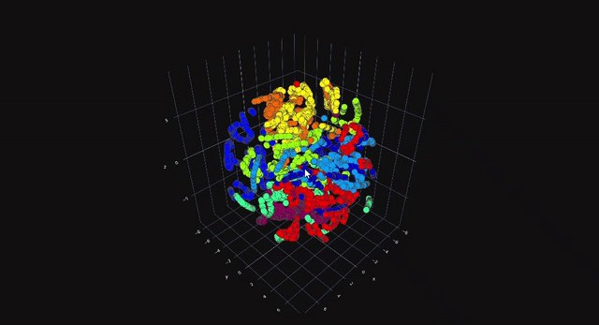
Example: 3D
Example credit: Sivakar Sivarajs, Towards Data Science

Slide 45
Potential issues with t-SNE?

Slide 46



UMAP (Uniform Manifold Approximation and Projection)
Same objective: preserve pairwise distances
Added constraint: make it scale
Different approach: probability and topology!
(use mathematical magic to find a locally-connected manifold)
Key differences:
Data doesn’t need to be normalized first, because we’re working with a probability distribution (which is already scaled to [0,1])
Initial assignment isn’t random (➔ more stable across runs)
We can control the balance between local and global structure preservation by manipulating hyperparameters
(such as how many neighbors are considered, etc.)

Slide 47
Example: 1st two PCs
Example credit: Sivakar Sivarajs, Towards Data Science

Slide 48
Example: t-SNE
Example credit: Sivakar Sivarajs, Towards Data Science

Slide 49
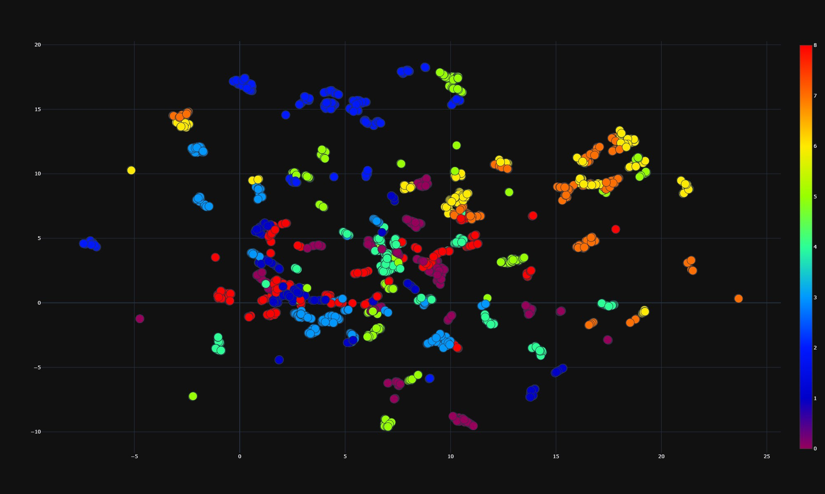
Example: UMAP
Example credit: Sivakar Sivarajs, Towards Data Science

Slide 50

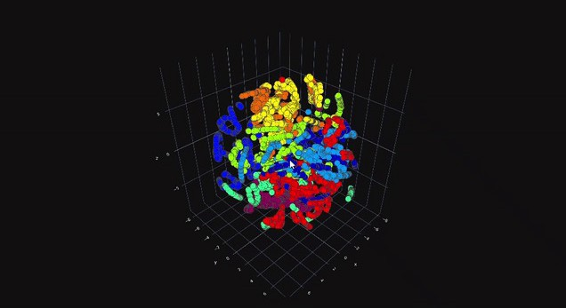
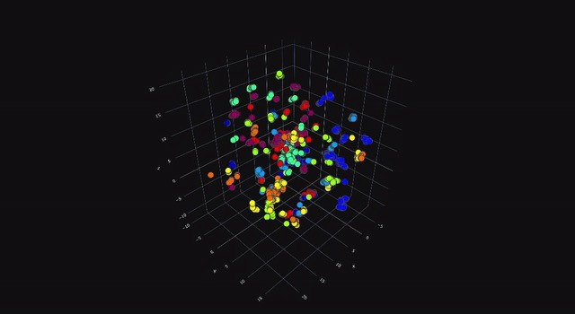
Example: 3D
Example credit: Sivakar Sivarajs, Towards Data Science

Slide 51
Takeaways
There’s no “one right answer”
Each technique has benefits and drawbacks:
MDA (or PCA) is great if you eventually need to be able to relate the result back to the original dimensions
t-SNE does a great job preserving local similarity, but sometimes at the expense of global structure (and it can get really slow)
UMAP is much faster, but you have to tune the hyperparameters so your clusters are neither to dense nor too spread out

Slide 52
Coming up
Thursday:
DC5 workshop
Communicating Uncertainty (async lecture)
Tuesday: special topic TBD

